Slide 1
Software Design
Introduction to Software Engineering
College of Computer Studies
De La Salle University - Manila

Slide 2

Motivation
Why bother with
Software Design?

Slide 3
Importance of Software Design
Maintain
Maintain
Test
Implement
Test
Design
Implement
With design
Without design

Slide 4
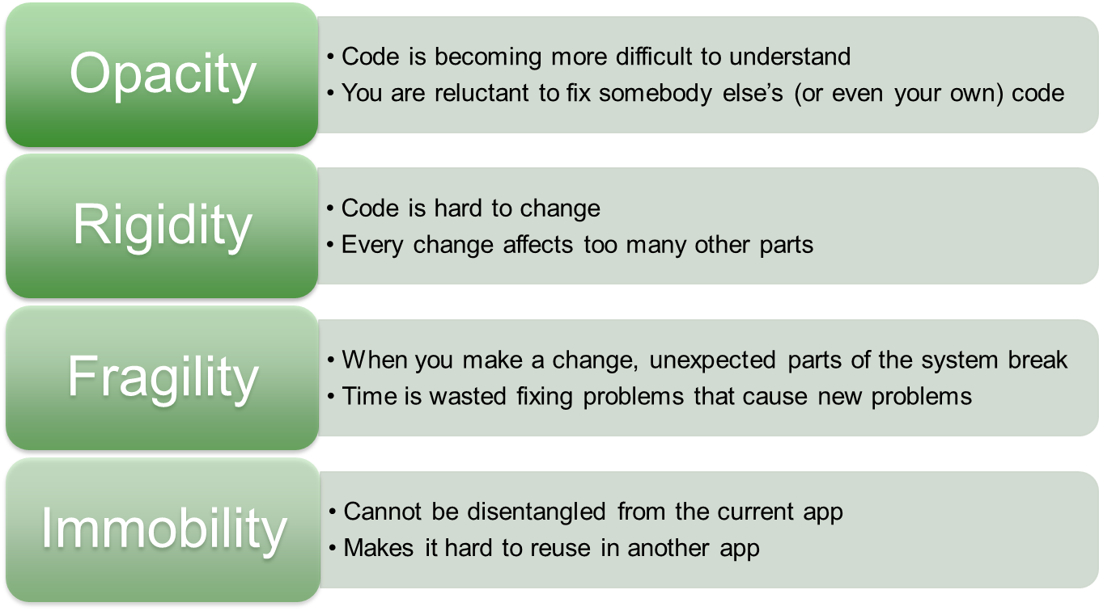
Symptoms of Poor Design

Slide 5
Software Design
“What is your solution
to the problem?”
as Product, model or representation of solution to be built
as Process, applying techniques and principles to arrive at a solution
Notes:
Pfleeger, 2nd Ed p 159 -161

Slide 6
Software Design
Deciding how the requirements should be implemented, using the available technology
Includes:
  Systems engineering: Deciding what should be in hardware and what in software
  Software architecture: Dividing the system into subsystems and deciding how the subsystems will interact
  Detailed design of the internals of a subsystem
  User interface design
  Design of databases
Object-Oriented Software Engineering (www.lloseng.com)

Slide 7
The Process of Design
A problem-solving process
Objective: To find and describe a way:
  To implement the system’s functional requirements
  While respecting the constraints imposed by the quality, platform and process requirements, and budget
  And while adhering to general principles of good quality
Object-Oriented Software Engineering (www.lloseng.com)

Slide 8
Benefits of Design
Good Design
  Makes project easy
  Directly linked to Good Quality Software
  Minimizes downstream costs
Bad Design
  Makes project impossible
  Cannot be rescued by good construction
  Unstable system
    Fail when small changes are made
    Difficult to test
    Quality can not be assessed
Notes:
Good & Bad (Sommervile, 5th Ed p 226
Rapid Development, p 143
Code Complete, p 35 )

Slide 9
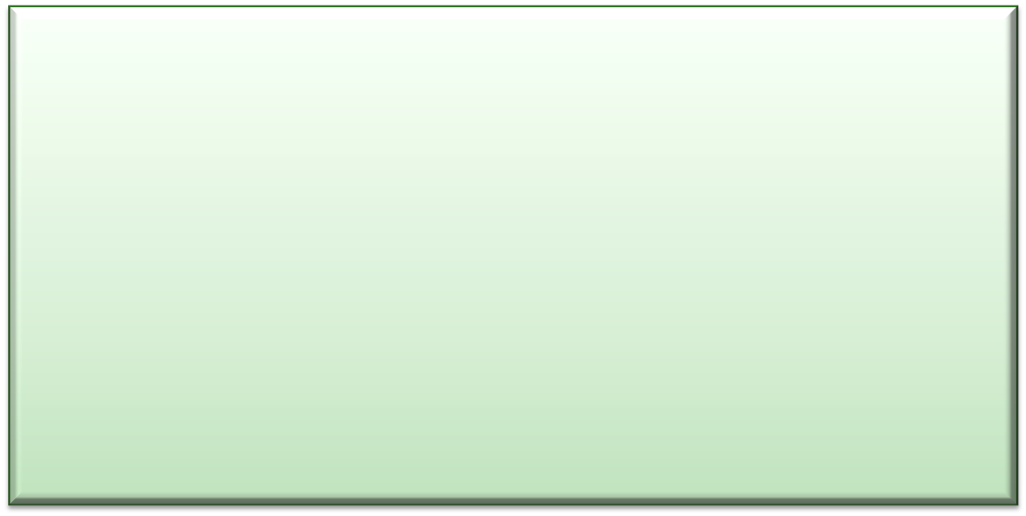
Software Design
How to solve
design problems?

Slide 10
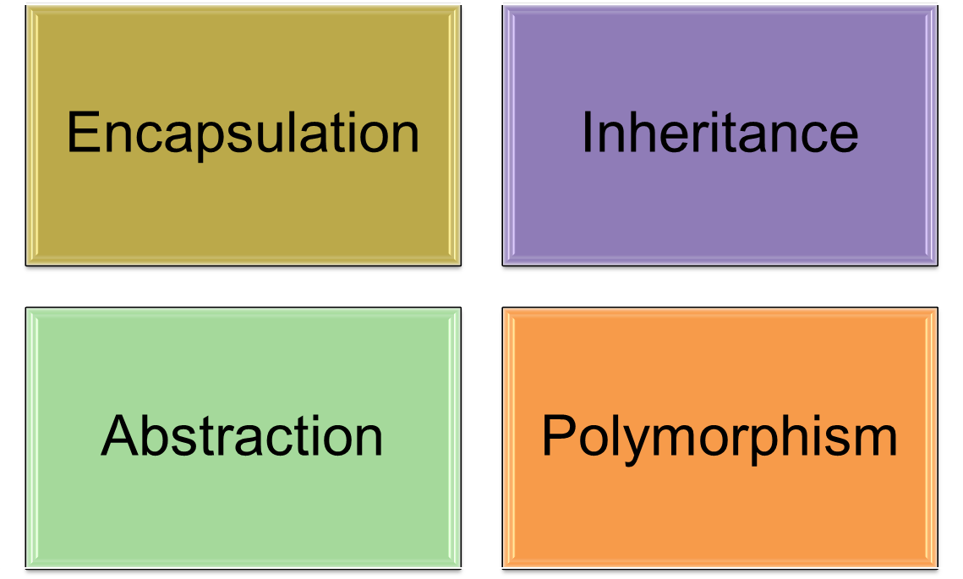
OOP Principles

Slide 11
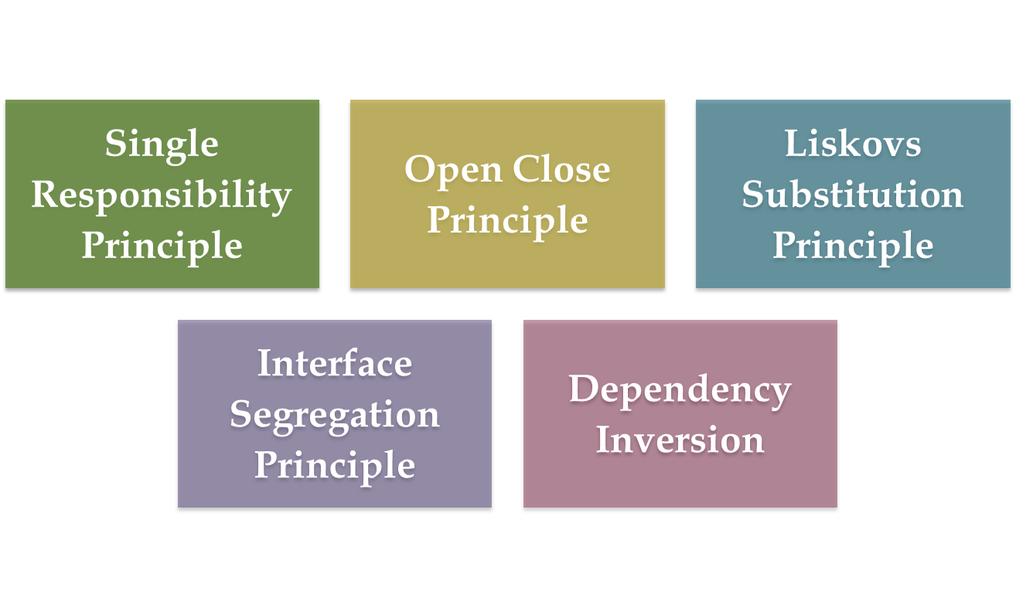
Software Design Principles

Slide 12

Single Responsibility Principle
A CLASS SHOULD HAVE
ONLY ONE REASON
TO CHANGE
Cohesion

Slide 13
Design Principles
Divide and Conquer
Increase Cohesion
Reduce Coupling
High Abstraction
Design for Reusability
Design with Reuse
Design for Flexibility
Anticipate Obsolescence
Design for Portability
Design for Testability
Design Defensively

Slide 14
Design Principle 1:
Divide and Conquer
Trying to deal with something big all at once is normally much harder than dealing with a series of smaller things
  Separate people can work on each part
  An individual software engineer can specialize
  Each individual component is smaller, and therefore easier to understand
  Parts can be replaced or changed without having to replace or extensively change other parts
Object-Oriented Software Engineering (www.lloseng.com)

Slide 15
Design Principle 2:
Increase Cohesion where possible
Cohesion - a measure of how well components ‘fit together’
A component should implement a single logical entity or function
The operations in a routine must be as closely related as possible
Payoff : higher reliability
  When a change has to be made, it is localized in a single cohesive component
Makes the system as a whole easier to understand and change
Type of cohesion:
  Functional, Layer, Communicational, Sequential, Procedural, Temporal, Utility

Slide 16
Functional Cohesion (Strong)
Each part of a component is necessary for the execution of a single function
All the code that computes a particular result is kept together, and everything else is kept out
  When a module only performs a single computation, and returns a result, without having side-effects
  Advantages – easier to understand, reusable, easier to replace
  Modules that update a database, create a new file or interact with the user are not functionally cohesive
Object-Oriented Software Engineering (www.lloseng.com)

Slide 17
Layer Cohesion
All the facilities for providing or accessing a set of related services are kept together, and everything else is kept out
  The layers should form a hierarchy
    Higher layers can access services of lower layers
    Lower layers do not access higher layers
  The set of procedures through which a layer provides its services is the application programming interface (API)
  A layer can be replaced without having any impact on the other layers ➔ You just replicate the API
Object-Oriented Software Engineering (www.lloseng.com)

Slide 18
Sequential Cohesion (Medium)
The output for one part of a component is the input to another part
Procedures, in which one procedure provides input to the next, are kept together, and everything else is kept out
  You should achieve sequential cohesion, only once you have already achieved the preceding types of cohesion
Object-Oriented Software Engineering (www.lloseng.com)

Slide 19
Communicational Cohesion (Medium)
Operations operate on the same input or produce the same output but the operations are not related
All the modules that access or manipulate certain data are kept together (e.g. in the same class), and everything else is kept out
  A class have good communicational cohesion if -
    All the system’s facilities for storing and manipulating its data are contained in this class
    The class does not do anything other than manage its data
  Main advantage: When you need to make changes to the data, you find all the code in one place
Object-Oriented Software Engineering (www.lloseng.com)

Slide 20
Procedural Cohesion (Weak)
The elements in a component make up a single control sequence
Procedures that are used one after another are kept together
  Even if one does not necessarily provide input to the next
  Weaker than sequential cohesion
Object-Oriented Software Engineering (www.lloseng.com)

Slide 21
Temporal Cohesion (Weak)
Components which are activated at the same time are grouped together
Operations that are performed during the same phase of the execution of the program are kept together, and everything else is kept out
  For example, placing together the code used during system start-up or initialization
  Weaker than procedural cohesion
Object-Oriented Software Engineering (www.lloseng.com)

Slide 22
Utility Cohesion (Weak)
When related utilities which cannot be logically placed in other cohesive units are kept together
  A utility is a procedure or class that has wide applicability to many different subsystems and is designed to be reusable
  For example, the java.lang.Math class
Logical Cohesion
  Components which perform similar functions are grouped
Coincidental Cohesion
  Parts of a component are simply bundled together

Slide 23
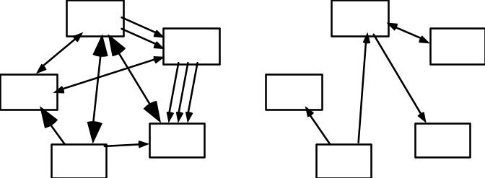
Design Principle 3:
Reduce Coupling where possible
Coupling: the strength of connection between two routines
  Occurs when there are interdependencies between two modules
  Changes in one place of the code will thus require changes somewhere else
  Type of coupling:
    Content, Common, Control, Stamp, Data, Routine Call, Type use, Inclusion/Import, External
Object-Oriented Software Engineering (www.lloseng.com)

Slide 24
Content Coupling (Must be avoided)
Occurs when one component modifies data that is internal to another component
  To reduce content coupling you should therefore encapsulate all instance variables
    Declare them private
    Provide getters and setters
Object-Oriented Software Engineering (www.lloseng.com)

Slide 25
Common Coupling (Must be avoided)
Occurs whenever you use a global variable
  All the components using the global variable become coupled to each other
  Can be acceptable for creating global variables that represent system-wide default values
Object-Oriented Software Engineering (www.lloseng.com)

Slide 26
Control Coupling (Must be avoided)
Occurs when one procedure calls another using a ‘flag’ or ‘command’ that explicitly controls what the second procedure does
  To make a change you have to change both the calling and called method
  To avoid or reduce control coupling:
    Use polymorphic operations
    Use look-up table where commands are mapped to a method that should be called when that command is issued
Object-Oriented Software Engineering (www.lloseng.com)

Slide 27
Stamp Coupling (Tolerable)
Occurs whenever one of your application classes is declared as the type of a method argument
Data structures are passed as parameters
  Since one class now uses the other, changing the system becomes harder
    Reusing one class requires reusing the other
  Two ways to reduce stamp coupling:
    Use an interface as the argument type
    Pass simple variables
Object-Oriented Software Engineering (www.lloseng.com)

Slide 28
Data or Normal Coupling (Preferable)
Occurs when the types of method arguments are either primitive or simple library classes
  The more arguments a method has, the higher the coupling
    All methods that use the method must pass all the arguments
  Reduce coupling by not giving methods unnecessary arguments
  There is a trade-off between data coupling and stamp coupling
    Increasing one often decreases the other
Object-Oriented Software Engineering (www.lloseng.com)

Slide 29
Routine Call Coupling
Occurs when one routine (or method) calls another
  The routines are coupled because they depend on each other’s behaviour
  Routine call coupling is always present in any system
  If you repetitively use a sequence of two or more methods to compute something
    then you can reduce routine call coupling by writing a single routine that encapsulates the sequence
Object-Oriented Software Engineering (www.lloseng.com)

Slide 30
Type Use Coupling
Occurs when a module uses a data type defined in another module
  Occurs any time a class declares an instance variable or a local variable as having another class for its type
  If the type definition changes, then the users of the type may have to change
  Always declare the type of a variable to be the most general possible class or interface that contains the required operations
Object-Oriented Software Engineering (www.lloseng.com)

Slide 31
Inclusion or Import Coupling
Occurs when one component imports a package (as in Java) or when one component includes another (as in C++)
  The including or importing component is now exposed to everything in the included or imported component.
  If the included/imported component changes something or adds something.
    This may raises a conflict with something in the includer, forcing the includer to change.
  An item in an imported component might have the same name as something you have already defined.
Object-Oriented Software Engineering (www.lloseng.com)

Slide 32
External Coupling
When a module has a dependency on such things as the operating system, shared libraries or the hardware
  Try to reduce the number of places in the code where such dependencies exist
Object-Oriented Software Engineering (www.lloseng.com)

Slide 33
Design Principle 4: Keep the level of Abstraction as high as possible
Ensure that your designs allow you to hide or defer consideration of details, thus reducing complexity
  A good abstraction is said to provide information hiding
  Abstractions allow you to understand the essence of a subsystem without having to know unnecessary details
Object-Oriented Software Engineering (www.lloseng.com)

Slide 34
Abstraction and Classes
Classes are data abstractions that contain procedural abstractions
  Attributes and associations are also data abstractions
  Methods are procedural abstractions
  Abstraction is increased by defining all variables as private
  The fewer public methods in a class, the better the abstraction
  Superclasses and interfaces increase the level of abstraction
Object-Oriented Software Engineering (www.lloseng.com)

Slide 35
Design Principle 5:
Increase Reusability where possible
Design the various aspects of your system so that they can be used again in other contexts
  Generalize your design as much as possible
  Follow the preceding three design principles
  Design your system to contain hooks
  Simplify your design as much as possible
Object-Oriented Software Engineering (www.lloseng.com)

Slide 36
Design Principle 6: Reuse Existing Designs and Code where possible
Design with reuse is complementary to design for reusability
  Actively reusing designs or code allows you to take advantage of the investment you or others have made in reusable components
    Cloning should not be seen as a form of reuse
Object-Oriented Software Engineering (www.lloseng.com)

Slide 37
Design Principle 7:
Design for Flexibility
Actively anticipate changes that a design may have to undergo in the future, and prepare for them
  Reduce coupling and increase cohesion
  Create abstractions
  Do not hard-code anything
  Leave all options open
    Do not restrict the options of people who have to modify the system later
  Use reusable code and make code reusable
Object-Oriented Software Engineering (www.lloseng.com)

Slide 38
Design Principle 8:
Anticipate Obsolescence
Plan for changes in the technology or environment so the software will continue to run or can be easily changed
  Avoid using early releases of technology
  Avoid using software libraries that are specific to particular environments
  Avoid using undocumented features or little-used features of software libraries
  Avoid using software or special hardware from companies that are less likely to provide long-term support
  Use standard languages and technologies that are supported by multiple vendors
Object-Oriented Software Engineering (www.lloseng.com)

Slide 39
Design Principle 9:
Design for Portability
Have the software run on as many platforms as possible
  Avoid the use of facilities that are specific to one particular environment
  E.g. a library only available in Microsoft Windows
Object-Oriented Software Engineering (www.lloseng.com)

Slide 40
Design Principle 10:
Design for Testability
Take steps to make testing easier
  Design a program to automatically test the software
    Ensure that all the functionality of the code can by driven by an external program, bypassing a graphical user interface
  In Java, you can create a main() method in each class in order to exercise the other methods
Object-Oriented Software Engineering (www.lloseng.com)

Slide 41
Design Principle 11:
Design Defensively
Never trust how others will try to use a component you are designing
  Handle all cases where other code might attempt to use your component inappropriately
  Check that all of the inputs to your component are valid: the preconditions
    Unfortunately, over-zealous defensive design can result in unnecessarily repetitive checking
Object-Oriented Software Engineering (www.lloseng.com)

